Slide 1
Predictive Modelling for business forecasting
Task 2
Author: Oarabile mathibela

Slide 2
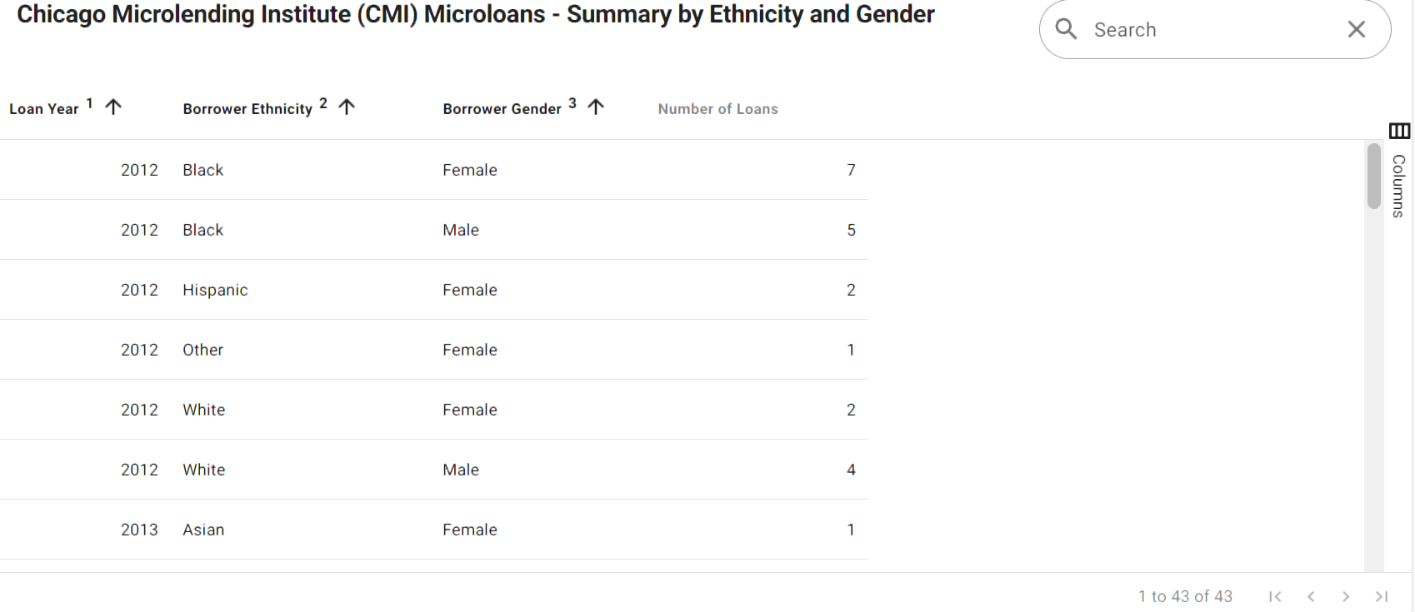
DataSet

Slide 3
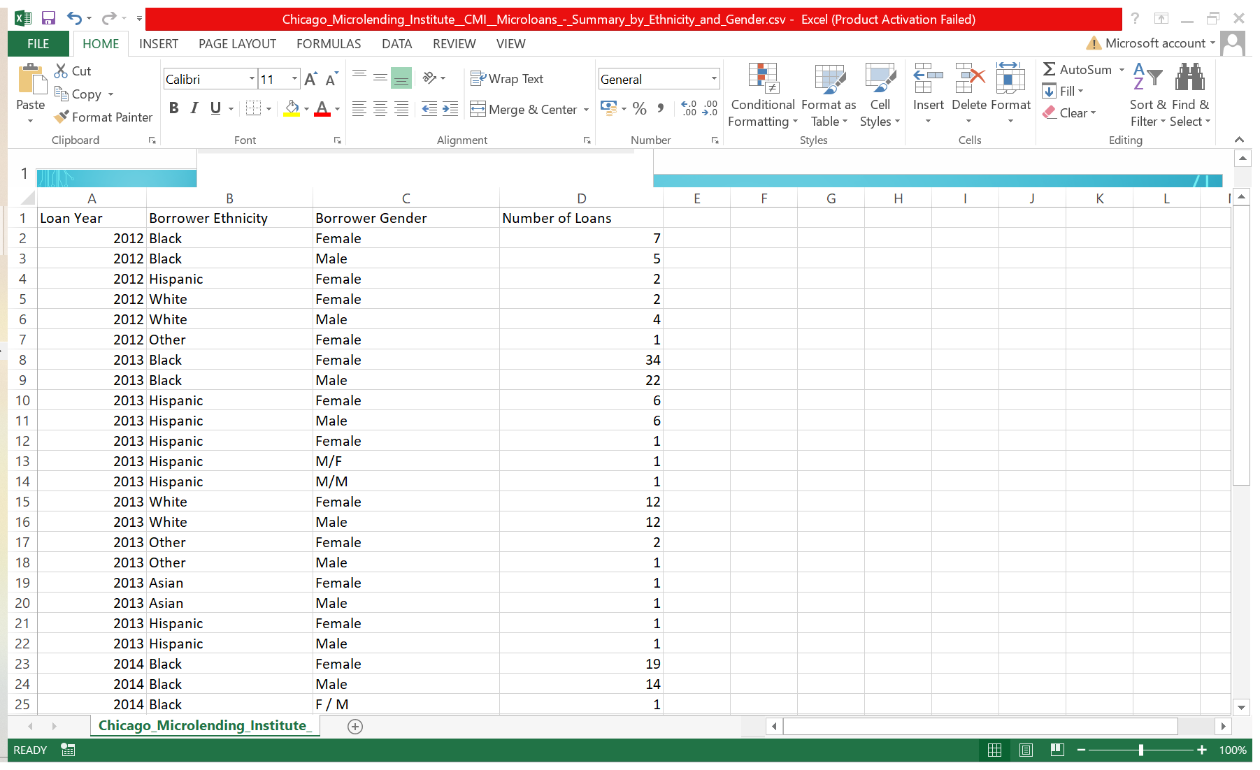

Slide 4
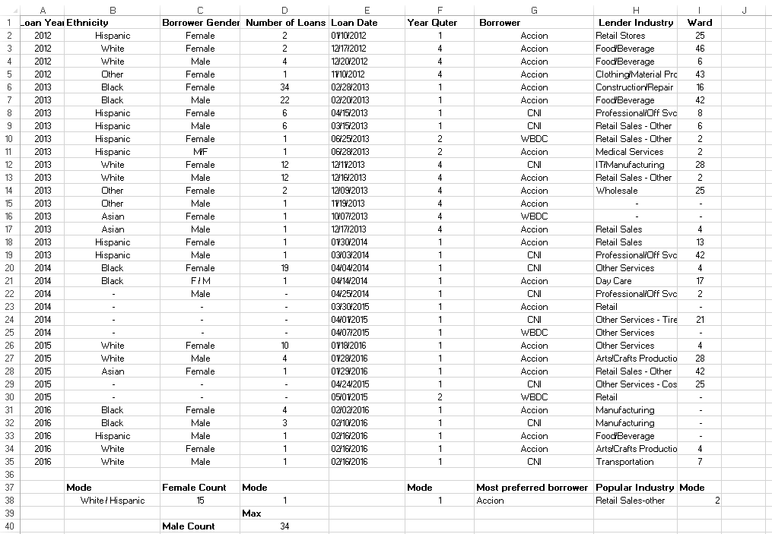
1. Feature selection and Engineering

Slide 5
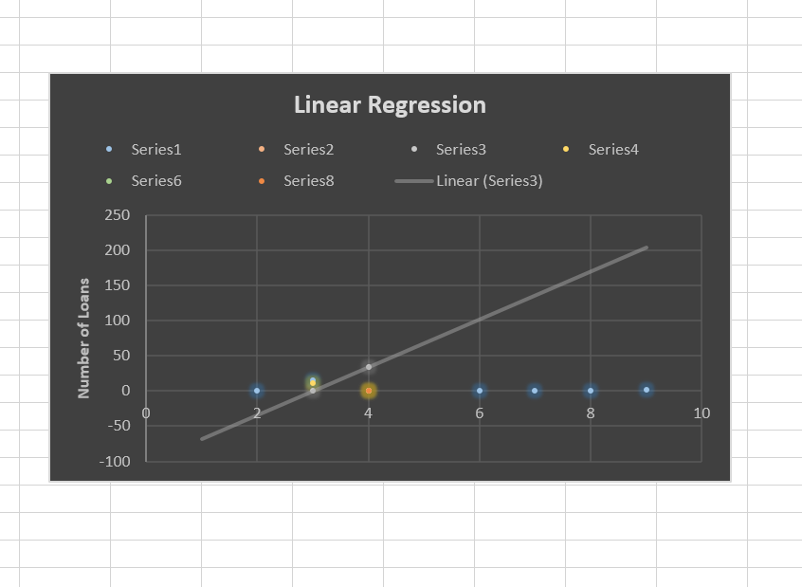
2. Model selection and development

Slide 6
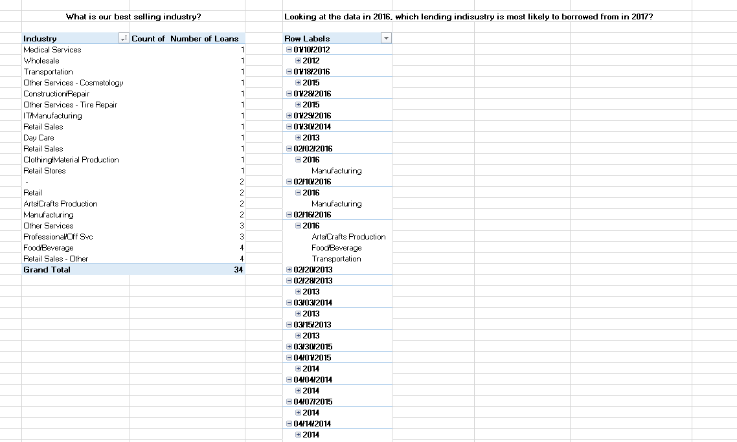
3. Predictive insight

Slide 7
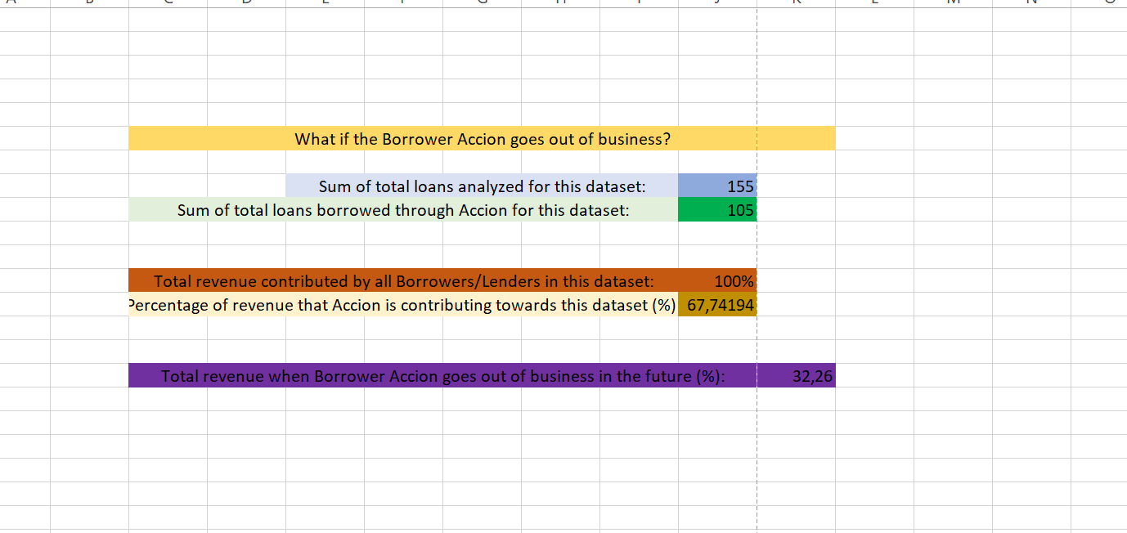
4. Forecasting and scenario analysis

Slide 8
Thank you

